Slide 1

Automated tap water system
Sl No. | Name | Class Roll No. | University Roll No.
1. | Subarna Kumar Maiti | 21 | 10400118055
2. | Soumik Laik | 29 | 10400118063
3. | Sonali Kumari | 30 | 10400118064
4. | Shubham Mondal | 34 | 10400118068
5. | Shibashis Banerjee | 37
6. | Tanmoy Guha Roy | 06

Slide 2
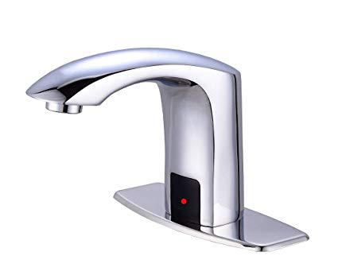
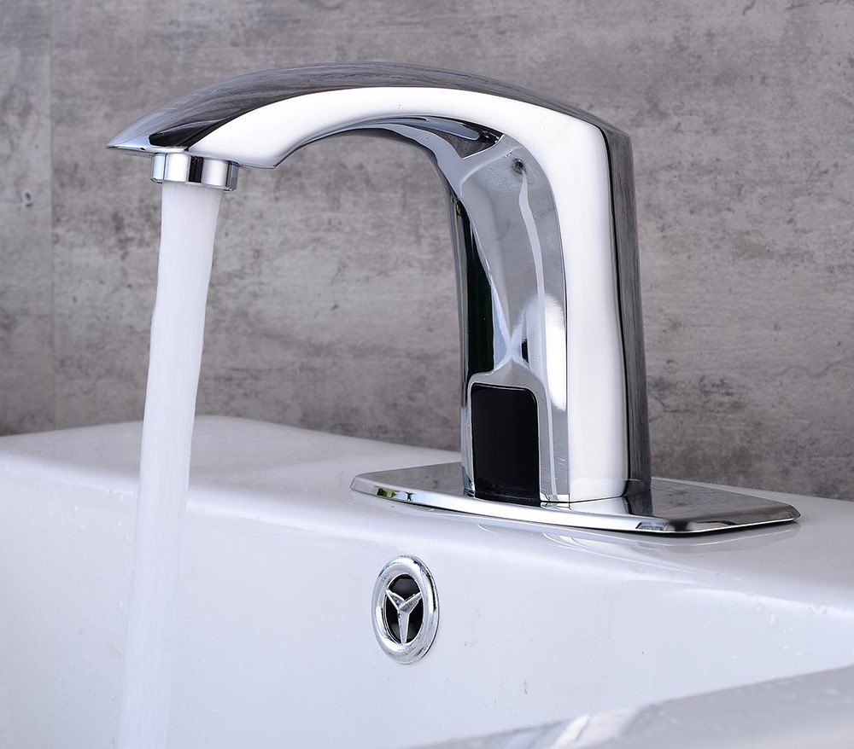
INTRODUCTION
An automatic tap is a faucet/tap is equipped with a proximity sensor/IR Sensor and a mechanism that opens its valve to allow water to flow in response to the presence of a hand or hands in close proximity. The faucet closes its valve again after a few seconds or when it no longer detects the presence of hands. Most automatic faucets are battery powered and incorporate an active infrared sensor to detect hand motion.

Slide 3
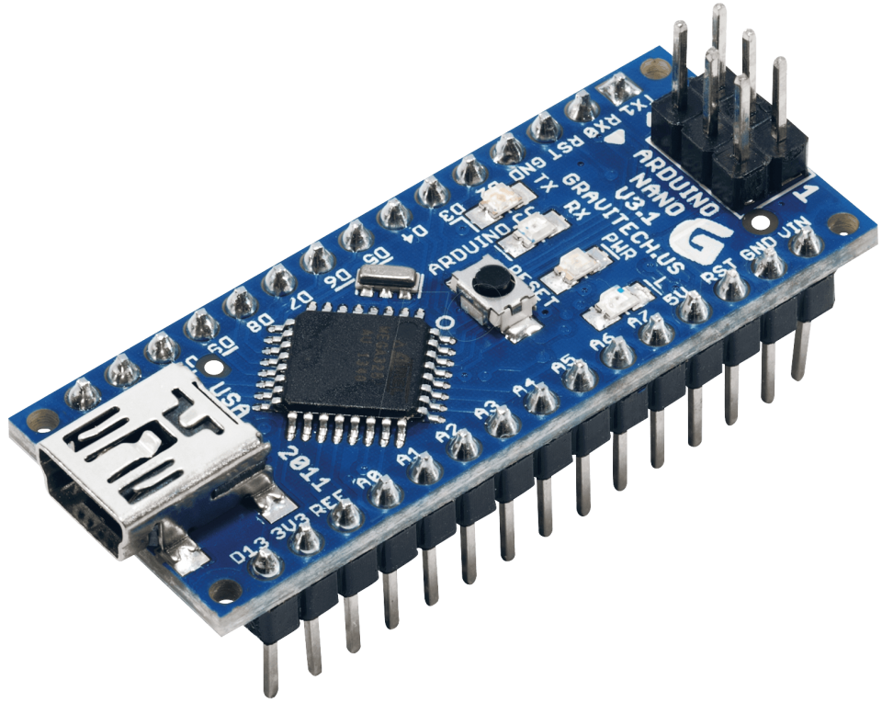
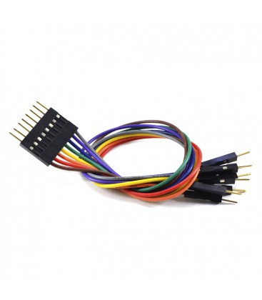

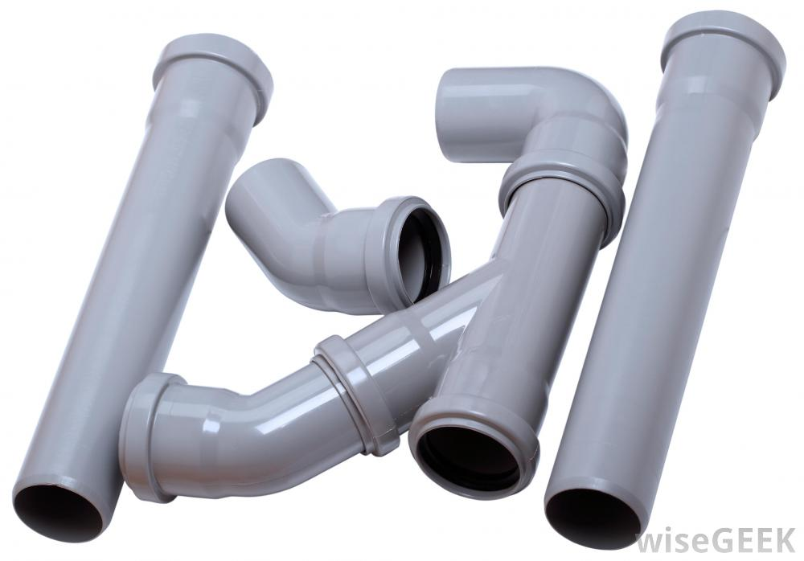
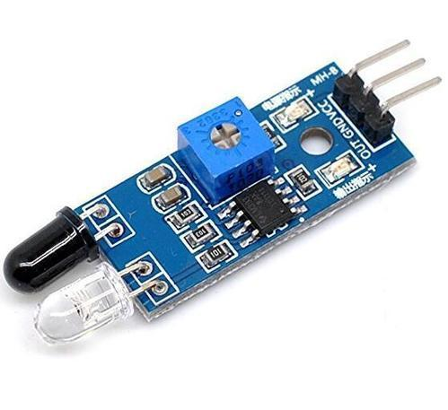
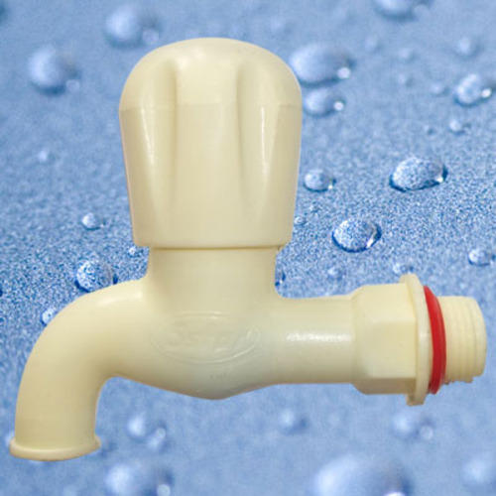
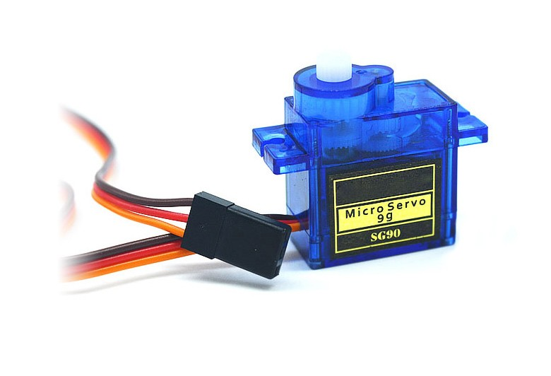

LIST OF COMPONENTS
Arduino Nano, (ATMega328p)
Battery (9V battery)
USB Cable
IR sensor(3pin)
Servo motor(MG995)
Wires for connection
PLASTIC TAP
Pipes and Joints
LIST OF COMPONENTS
9V BATTERY
Pipes and Joints
SERVO MOTOR(MG995)
JUMPER WIRES
ARDUINO NANO
IR SENSOR
TAP

Slide 4

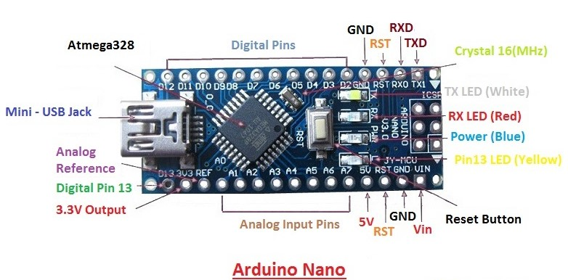
ARDUINO NANO
AND IT’S PIN CONFIG

Slide 5
PROGRAM(ARDUINO CODE)
#include<Servo.h>
Servo tap_servo;
int sensor_pin = 9;
int tap_servo_pin = 6;
int val;
void setup(){
pinMode(sensor_pin, INPUT);
tap_servo.attach(tap_servo_pin);
}
void loop(){
val = digitalRead(sensor_pin);
if(val==0){
tap_servo.write(0);
}
if(val==1){
tap_servo.write(75);
}
}

Slide 6
WORKING PRINCIPLE
The concept behind the Automatic Water Dispenser is very simple. The whole system is powered using a 9-voltbattery. An IR receiver & transmitter pair is used to sense the presence of hand below the tap. IR transmitter transmits infrared light and when something obstructs the light, it is reflected back to the receiver. The resistance of the receiver decreases with increased infrared light. The output of IR receiver is taken by a microcontroller and compared it to a preset value. If it receives more light compare to preset value of threshold then it sent a signal to a servo motor and servomotor rotate the knob of the water tap. As a result, when the hand is kept below the tap, water flows. . It waits till the object is removed; once the object is removed the IR sensor sends signals to the servo motor through the arduino board to rotate in opposite direction, thus closing the flow of water. The IR sensor and the servo is programmed using Arduino UNO/NANO board. The Arduino code is written in Arduino IDE.

Slide 7
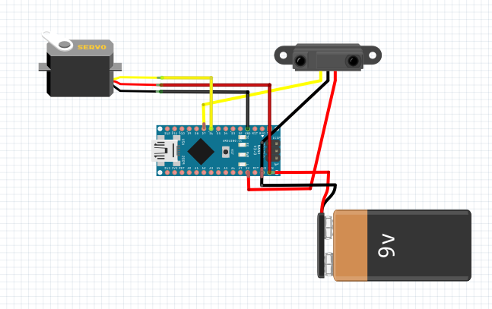
SCHEMATICS
Fritzing is used to make and design an overview of the connections of the circuit.

Slide 8
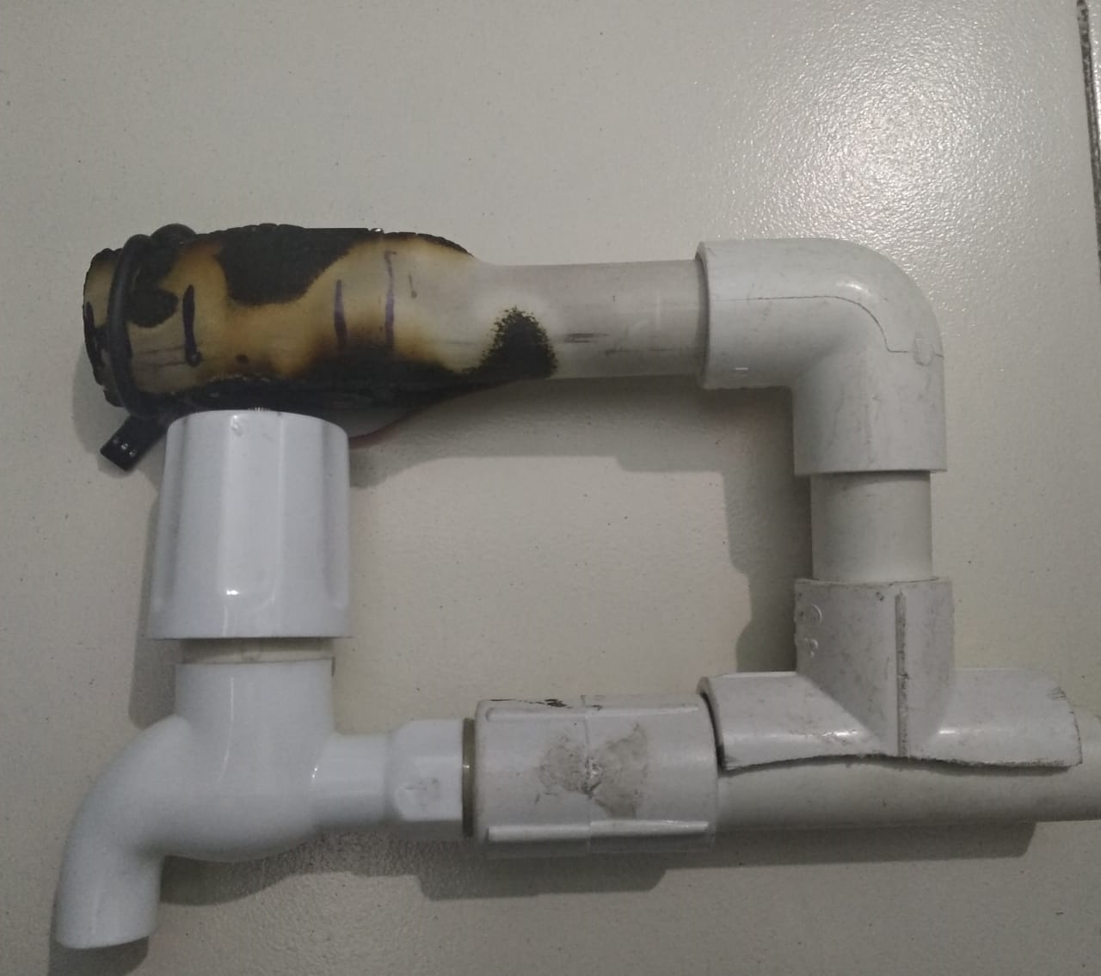
Connection of the tap with servo motor
The tap is fitted to the servo motor using pipes and joints

Slide 9

WORKING OF THE MODEL
The working of the model is shown in the given video

Slide 10
PROS OF THE AUTOMATED TAP
Reduced direct human labor costs and expenses
Simple design
Economical or cost effective
Increased consistency and productivity
Hands free and easy to operate
Helps to stop the spread of germs and bacteria.
Prevents water overflow with automatic turn off
Better efficiency as they act as a check on water usage
FUTURE PROSPECTIVES
The automated tap can be connected to a NodeMCU and the data on how much time the water flows can be recorded.
App can be developed and can be connected to it to remotely monitor the flow of water due to malfunction of sensor or presence of other obstacles.

Slide 11
CONCLUSION
As the world is getting more technologically driven, people are interested in getting things done quickly and without much effort, this encourages engineers to invent new machineries. One of these things is the automated tap water system. This project gave good experience about practical field.

